Slide 1
Images and Color
Multimedia Systems (Module 1 Lesson 2)
Summary:
Basic concepts underlying Images
Popular Image File formats
Human perception of color
Various Color Models in use and the idea behind them
Sources:
My Research Notes
Dr. Ze-Nian Li’s course material at:
http://www.cs.sfu.ca/CourseCentral/365/li/
Follow this link for a great read on color:
http://www.adobe.com/support/techguides/color/colortheory/
Notes:
In this lesson we will study the fundamentals underlying Images, look at popular Image file formats.
Various image and video representations use different color models. Some are based on human perception of color. We will look at the human perception of color in both qualitative and more importantly quantitative terms.
We will look at the motivation behind the color models in use today and how they have been arrived at.
The sources for this my own research notes, Dr. Ze-Nian Li’s lecture notes and some helpful literature from adobe.

Slide 2
Graphics: Terminology
Pixels -- picture elements in digital images
Image Resolution -- number of pixels in a digital image (Higher resolution always yields better quality.)
  width x height (e.g., 640X480)
  Most common Aspect ratio: 3:4 (lines:columns)
  Dots (pixels) per inch, dpi or ppi (e.g., 72 dpi)
Bit-Map -- a representation for the graphic/image data in the same manner as they are stored in video memory.
Bits/pixel – also contributes to the quality of the image
Notes:
First lets take care of some terminology.
Pixel, short for a picture element is the smallest unit of an digital image
The resolution of images are expressed in terms of number of pixels, however, images being two dimensional, it is customary to express the resolution as X by Y, for example 640X480 which is 640 columns by 480 rows, or height x width, or columns x lines.
Another way of expression resolution is to use the aspect ratio which is the ratio of the lines to the columns.
These opposite definitions often cause confusion.

Slide 3
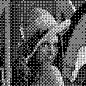

Monochrome vs. Grayscale
Monochrome:
Each pixel is stored as a single bit (0 or 1)
A 640 x 480 monochrome image requires 37.5 KB of storage.
Grayscale:
Each pixel is usually stored as a byte (value between 0 to 255)
A 640 x 480 grayscale image requires over 300 KB of storage.

Slide 4
Dithering
Dithering is often used for displaying monochrome images
Creating the illusion of new colors and shades by varying the pattern of dots. Newspaper photographs, for example, are dithered. If you look closely, you can see that different shades of gray are produced by varying the patterns of black and white dots. There are no gray dots at all. The more dither patterns that a device or program supports, the more shades of gray it can represent.
In printing, dithering is usually called halftoning, and shades of gray are called halftones. Note that dithering differs from gray scaling. In gray scaling, each individual dot can have a different shade of gray.
Notes:
Of course we are talking about b/w picture in newspapers.

Slide 5
Color Images (24 vs. 8 bit)
24-bit:
Each pixel is represented by three bytes (e.g., RGB)
Supports 256 x 256 x 256 possible combined colors (16,777,216)
A 640 x 480 24-bit color image would require 921.6 KB of storage
Many 24-bit color images are stored as 32-bit images, the extra byte of data for each pixel is used to store an alpha value representing special effect information
8-bit:
One byte for each pixel
Supports 256 out of the millions colors possible, acceptable color quality
Requires Color Look-Up Tables (LUTs) -- Pallete
A 640 x 480 8-bit color image requires 307.2 KB of storage (the same as 8-bit grayscale)
Notes:
A color lookup table for a 8-bit image is a table with 256 entries where each entry may is a 24 bit value that represents a particular color. The idea is to use this table to eliminate colors or shades of color that are not common.

Slide 6
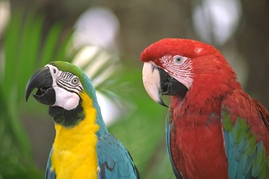
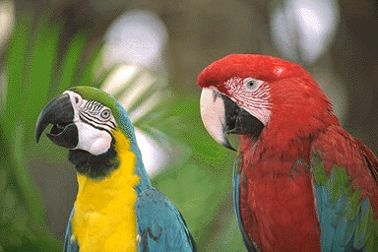
24-bit color (60KB jpeg)
8-bit color (30KB gif)

Slide 7
System Independent Formats
GIF(GIF87a,GIF89a):
Graphics Interchange Format (GIF) devised by the UNISYS Corp. and Compuserve, initially for transmitting graphical images over phone lines via modems.
Uses the Lempel-Ziv Welch algorithm (compression).
Supports only 8-bit (256) color images.
Supports interlacing
GIF89a supports simple animation
JPEG:
A standard for photographic image compression created by the Joint Photographics Experts Group
Takes advantage of limitations in the human vision system to achieve high rates of compression
Lossy compression which allows user to set the desired level of quality/compression
Notes:
JPEG has some advanced modes that allow interlacing and progressive scanning however they are optional and therefore do not constitute the baseline JPEG.

Slide 8
…Contd
TIFF:
Tagged Image File Format (TIFF), stores many different types of images (e.g., monochrome, grayscale, 8-bit & 24-bit RGB, etc.)
Developed by the Aldus Corp. in the 1980's and later supported by Microsoft
TIFF is a lossless format (when not utilizing the new JPEG tag which allows for JPEG compression)
It does not provide any major advantages over JPEG and is not as user-controllable it appears to be declining in popularity
Graphics Animation Files:
FLC -- main animation or moving picture file format, originally created by Animation Pro
FLI -- similar to FLC
GL -- better quality moving pictures, usually large file sizes
Postscript/ PDF:
A typesetting language which includes text as well as vector/structured graphics and bit-mapped images
Used in several popular graphics programs (Illustrator, FreeHand)
Does not provide compression, files are often large

Slide 9
System Dependent Formats
Windows(BMP):
A system standard graphics file format for Microsoft Windows
It is capable of storing 24-bit bitmap images
Used in PC Paintbrush and other programs
Macintosh(PAINT, PICT):
PAINT was originally used in MacPaint program, initially only for 1-bit monochrome images.
PICT format is used in MacDraw (a vector based drawing program) for storing structured graphics
X-windows(XBM):
Primary graphics format for the X Window system
Supports 24-bit color bitmap
Many public domain graphic editors, e.g., xv
Used in X Windows for storing icons, pixmaps, backdrops, etc.

Slide 10
PNG: The Future
The Portable Network Graphics (PNG) format was designed to replace the older and simpler GIF format and, to some extent, the much more complex TIFF format.
Advantages over GIF:
  Alpha channels (variable transparency)
  Also known as a mask channel, it is simply a way to associate variable transparency with an image.
  Gamma correction (cross-platform control of image brightness)
  Two-dimensional interlacing (a method of progressive display)
  GIF uses 1-D interlacing. (see the difference in the example at
  http://data.uta.edu/~ramesh/multimedia/examples/interlacing.html )
  Better Compression (5-25% better)
Features:
  Supports three main image types: truecolor, grayscale and palette-based (``8-bit''). JPEG only supports the first two; GIF only the third.
Shortcomings:
  No Animation
Notes:
The two-dimensional interlacing used in PNG does not render the image faster that GIF, as a matter of fact the rendering time of both formats is the same. However, PNG renders a small fraction of the total image first and slowly refines the image in subsequent passes until the entire image is rendered.
Whereas interlaced GIF would render entire lines of the image skipping neighboring lines and then coming back in the subsequent passes to render skipped lines.

Slide 11
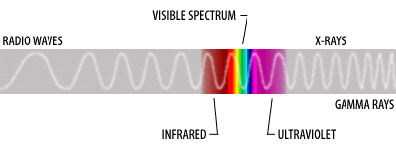
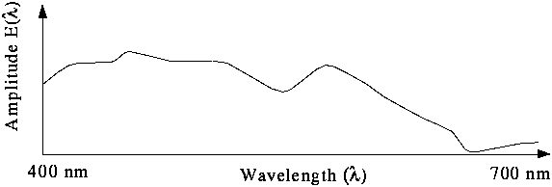
Color in Images and Video
Basics of Color
Light and Spectra
  Visible light is an electromagnetic wave in the 400 nm - 700 nm range.
  Most light we see is not one wavelength, it's a combination of many wavelengths.
Notes:
The graph shows the various wavelengths that make up the visible spectrum and their amplitudes.

Slide 12
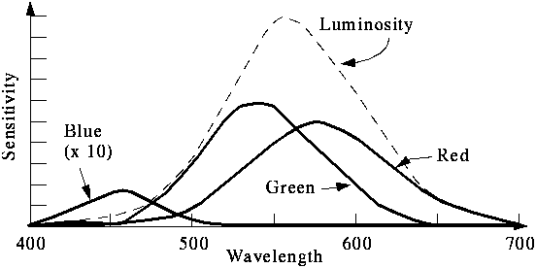
Basics of Color (…Contd)
The Human Retina
  The eye functions on the same principle as a camera
  Each neuron is either a rod or a cone.
  The rods contain the elements that are sensitive to light intensities. Rods are not sensitive to color.
  Cones come in 3 types: red, green and blue. Each responds differently to various frequencies of light. The following figure shows the spectral-response functions of the cones and the luminous-efficiency function of the human eye
Notes:
What we see in the picture is the sensitivity of the human eye to each of the colors that combine to form the various wavelengths of visible light.
We also note that the human eye is more sensitive to the luminosity content or brightness of the light that its color components.

Slide 13



Cones and Color
The cones provide humans with vision during the daylight and are believed to be separated into three types, where each type is more sensitive to a particular wavelength
The color signal to the brain comes from the response of the 3 cones to the spectra being observed. That is, the signal consists of 3 numbers:
where E is the light and S is the sensitivity function
Notes:
If E is the incident light and S is the sensitivity function of the human eye then the resulting signals generated by the three cones are given by these equations.
We note that if a person is color blind then he or she would have different sensitivity functions, further different animals may have different sensitivity functions.

Slide 14
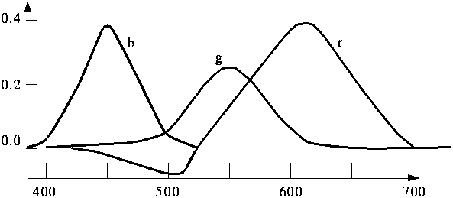
Color Composition
A color can be specified as the sum of three colors. So colors form a 3 dimensional vector space.
The following figure shows the amounts of three primaries needed to match all the wavelengths of the visible spectrum.
Notes:
Lets now take a look at what is the composition of the various wavelengths in terms of the three components red blue and green. This is different from the human perception or sensitivity, this is simply the composition of light.

Slide 15
Color Models for Images
RGB Additive Model
CRT displays have three phosphors (RGB) which produce a combination of wavelengths when excited with electrons
A color image is a 2-D array of (R,G,B) integer triplets. These triplets encode how much the corresponding phosphor should be excited in devices such as a monitor.
CMY Subtractive Model
Cyan, Magenta, and Yellow (CMY) are complementary colors of RGB.
CMY model is mostly used in printing devices where the color pigments on the paper absorb certain colors (e.g., no red light is reflected from cyan ink).
Blue
Cyan
Yellow
Red
Green
Black(1,1,1)
Magenta
White(1,1,1)
Green
Magenta
Black(0,0,0)
White(0,0,0)
Yellow
Cyan
Blue
Red

Slide 16
Color Models for Video
YUV Model
Human perception is more sensitive to luminance (brightness) than chrominance (color). Therefore, instead of separating colors, one can separate the brightness info. from the color info.
Y is luminance
  Y = 0.299R + 0.587G + 0.114B
Chrominance is defined as the difference between a color and a reference white at the same luminance. It can be represented by U and V -- the color differences.
  U = B - Y
  V = R - Y
Eye is most sensitive to Y. Therefore, any error in the resolution of the luminance (Y) is more important than the chrominance (U,V) values.
In PAL, 5 (or 5.5) MHz is allocated to Y, 1.3 MHz to U and V.
CD-I and DVI also use the YUV model
YIQ Model
Although U and V nicely define the color differences, they do not align with the desired human perceptual color sensitivities. Hence, I and Q are used instead.
  I = 0.74(R - Y) - 0.27(B - Y) = 0.596R - 0.275G - 0.321B
  Q = 0.48(R - Y) + 0.41(B - Y) = 0.212R - 0.523G + 0.311B
YIQ is used in NTSC color TV broadcasting, it is downward compatible with B/W TV where only Y is used.
Eye is most sensitive to Y, next to I, next to Q. In NTSC broadcast TV, 4.2 MHz is allocated to Y, 1.5 MHz to I, 0.55 MHz to Q.

Slide 17
Color Models for Video (…Contd)
YC_{b}C_{r} Color Model
The YC_{b}C_{r} model is closely related to the YUV, it is a scaled and shifted YUV.
  C_{b} = ((B - Y)/ 2) + 0.5
  C_{r} = ((R - Y) / 1.6) + 0.5
The chrominance values in YC_{b}C_{r} are always in the range of 0 to 1.
YC_{b}C_{r} is used in JPEG and MPEG.

Slide 18
Summary: Color
Color images are encoded as triplets of values.
RGB is an additive color model that is used for light-emitting devices, e.g., CRT displays. CMY is a subtractive model that is used often for printers
Sometimes, an alternative CMYK model (K stands for Black) is used in color printing (e.g., to produce darker black than simply mixing CMY).
K := min (C, M, Y); C := C – K; M := M – K; Y := Y - K.
Two common color models in imaging are RGB and CMY, two common color models in video are YUV and YIQ.
YUV uses properties of the human eye to prioritize information. Y is the black and white (luminance) image, U and V are the color difference (chrominance) images. YIQ uses similar idea.

